Slide 1

INDIA GENERAL ELECTION RESULTS ANALYSIS - 2024
📊
The Advanced and Real-Time Power BI Project with cutting-edge functionalities and features! This project is designed with five dynamic and visually stunning dashboards, delivering unparalleled insights.

Slide 2
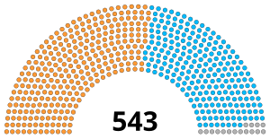

Project Objective:
The India General Election Results – 2024 dashboard aims to provide a comprehensive overview of the election outcomes with a focus on seat distribution among key alliances and independent candidates. The dashboard will help political analysts, researchers, and the general public gain insights into the election performance of major political groups.

Slide 3
🚀 What Makes This Project Exceptional?
🌟
Advanced Functionalities:
Dynamic Data Modeling across multiple tables.
Data Drill through
Data Drill Up/ Down
Bookmarks
Advanced DAX Functions, Calculated Measures, and Columns.
Seamless Data Cleaning in Power Query for flawless analysis.

Slide 4
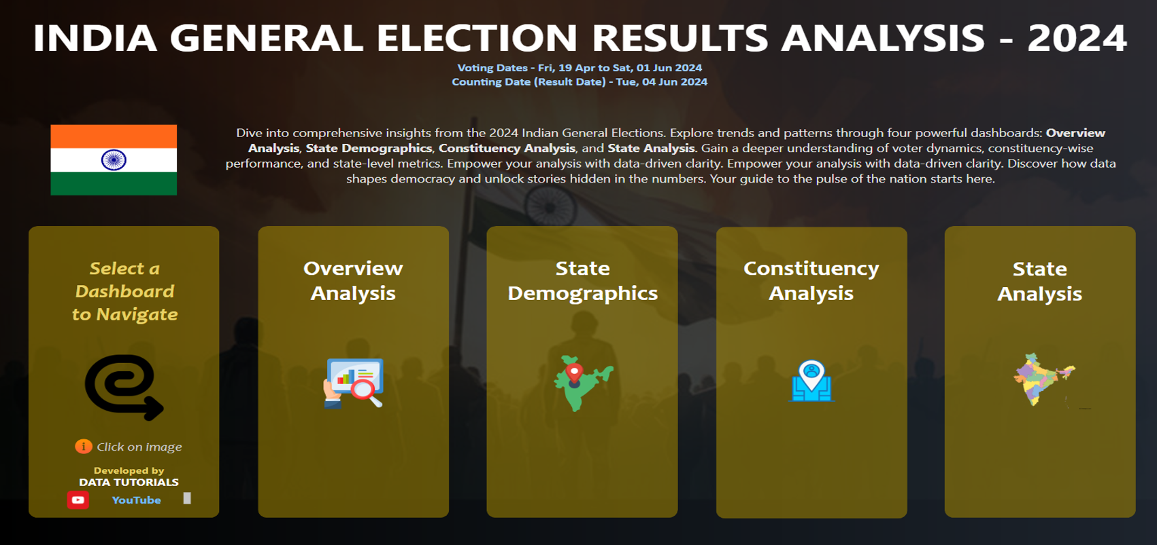
1️⃣ Landing Page – Engaging and interactive project entry.

Slide 5
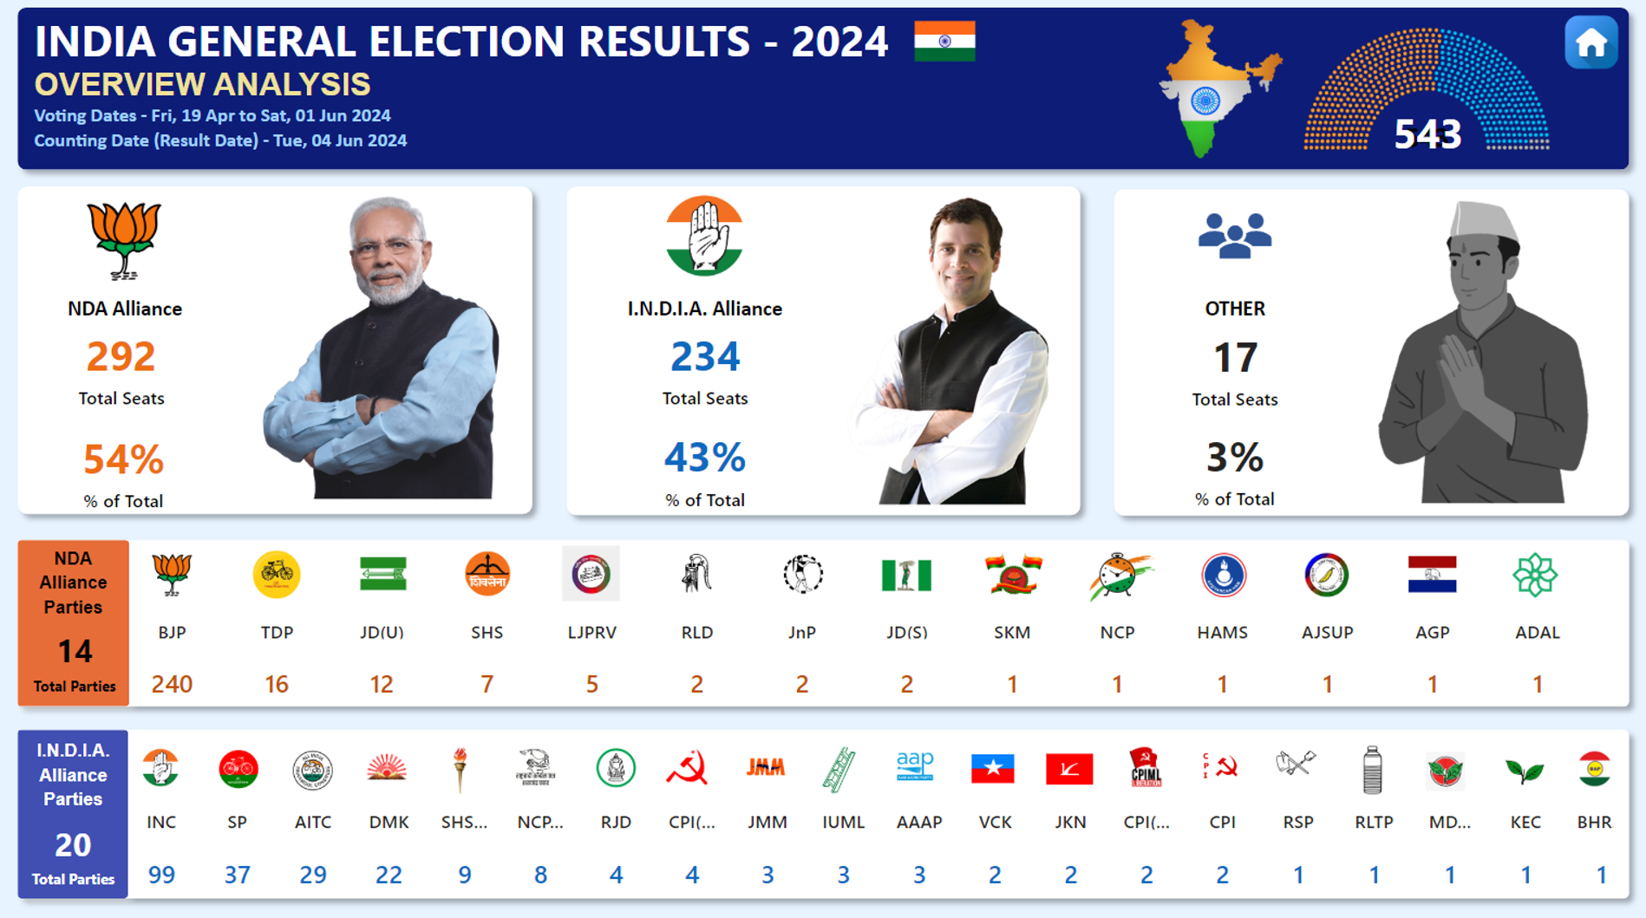
2️⃣ Overview Analysis – A comprehensive summary of results and trends.

Slide 6
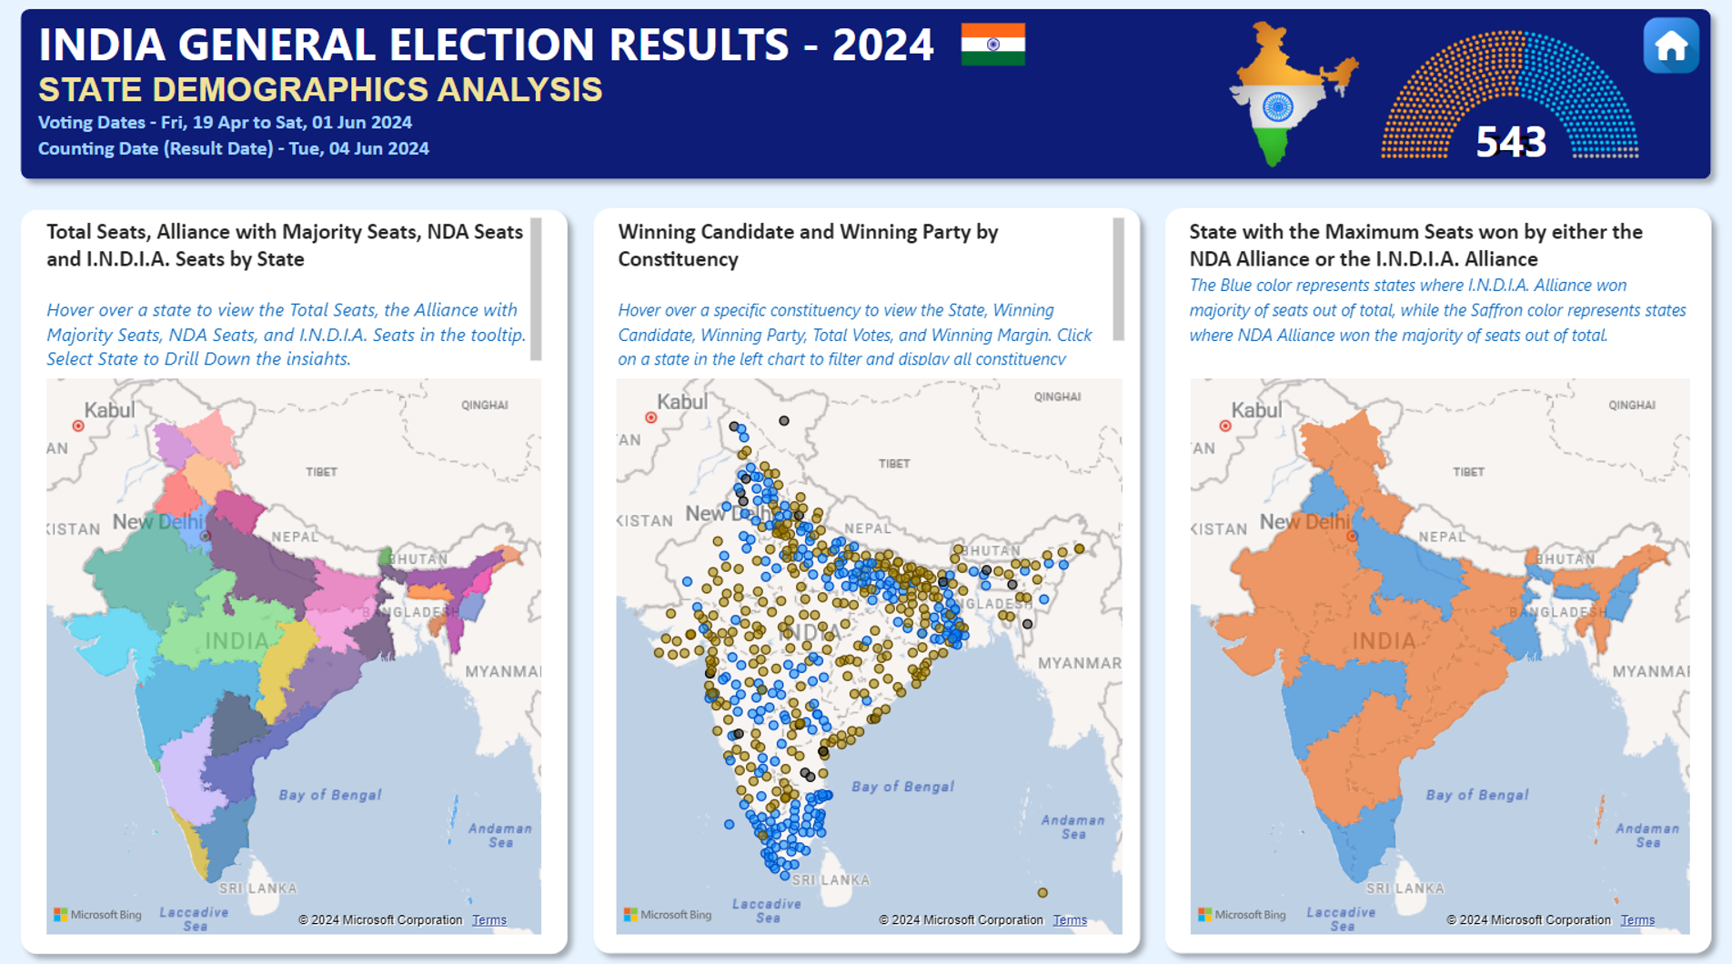
3️⃣ State Demographics – State-level insights with dynamic metrics.

Slide 7
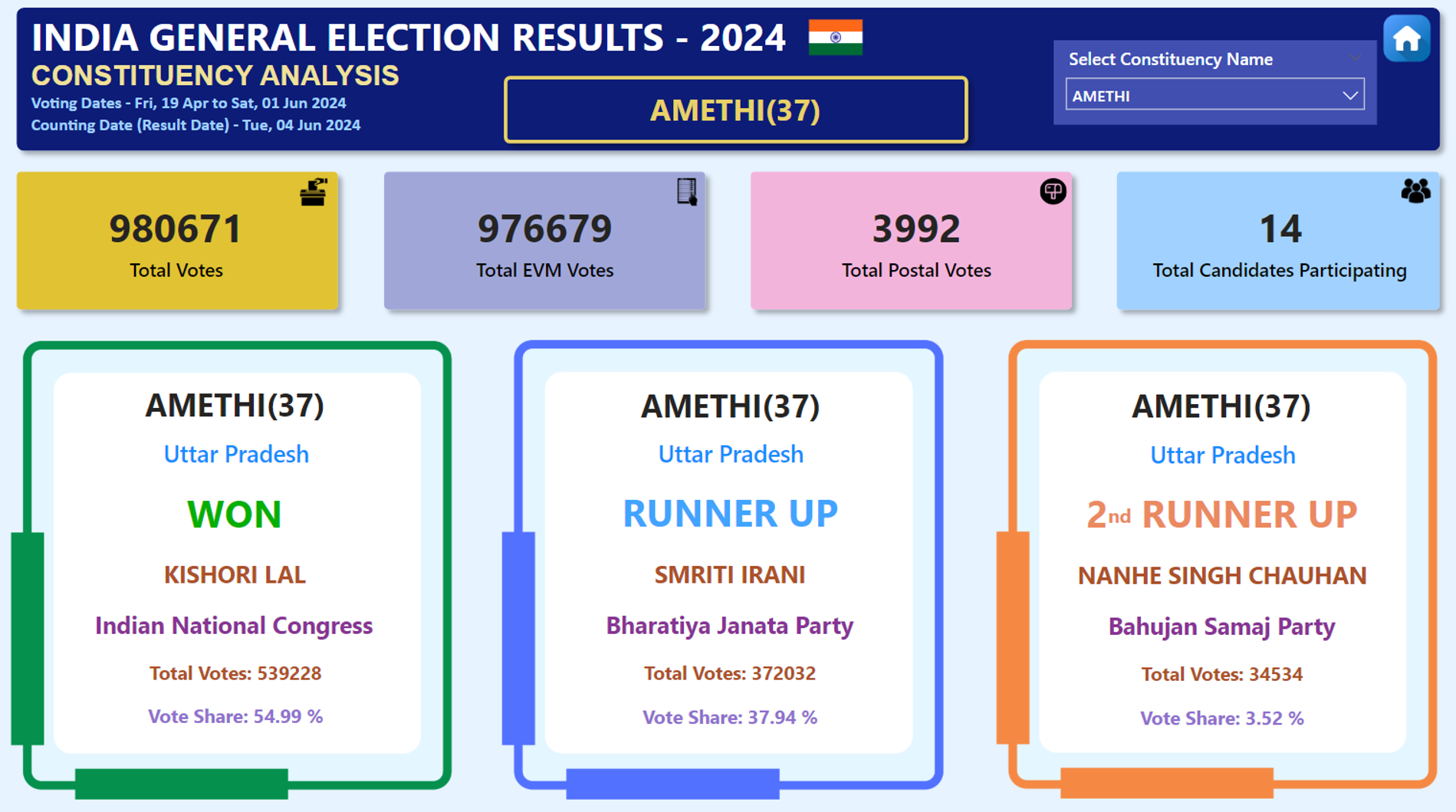
4️⃣ Constituency Analysis – Detailed constituency-level exploration.

Slide 8
4️⃣ Constituency Analysis – Detailed constituency-level exploration.

Slide 9
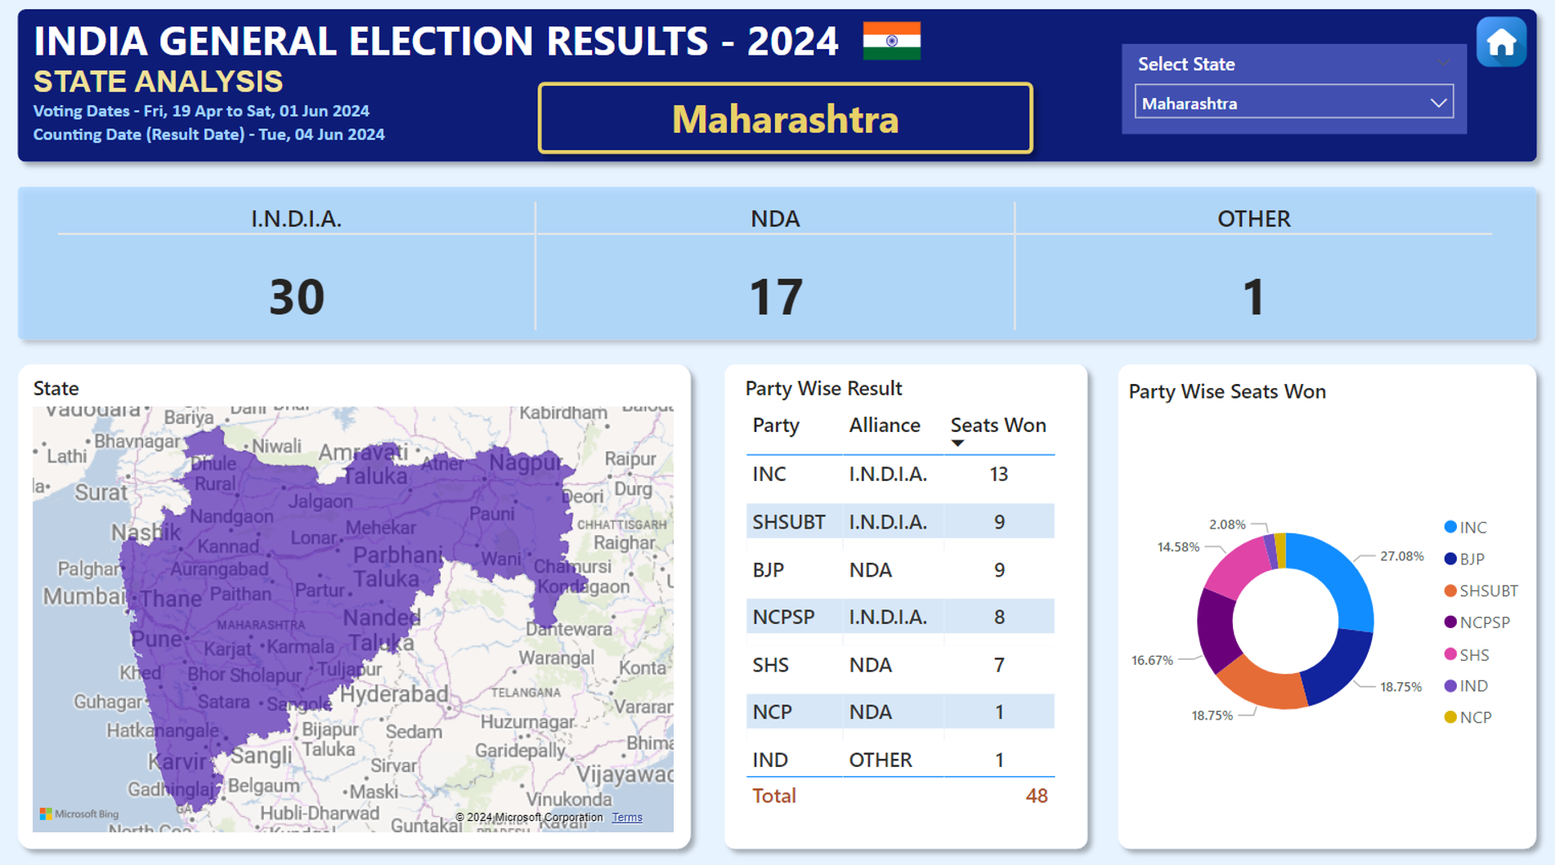
5️⃣ State Analysis – In-depth performance comparisons across states.

Slide 10
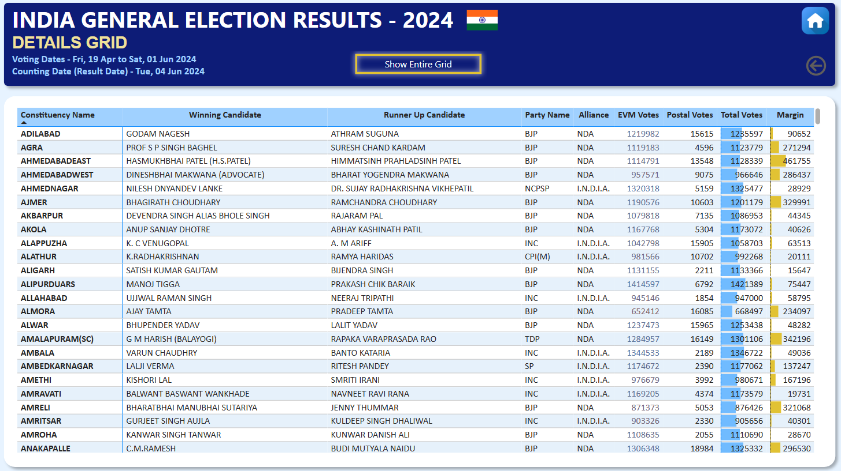
5️⃣ State Analysis – In-depth performance comparisons across states.

Slide 11
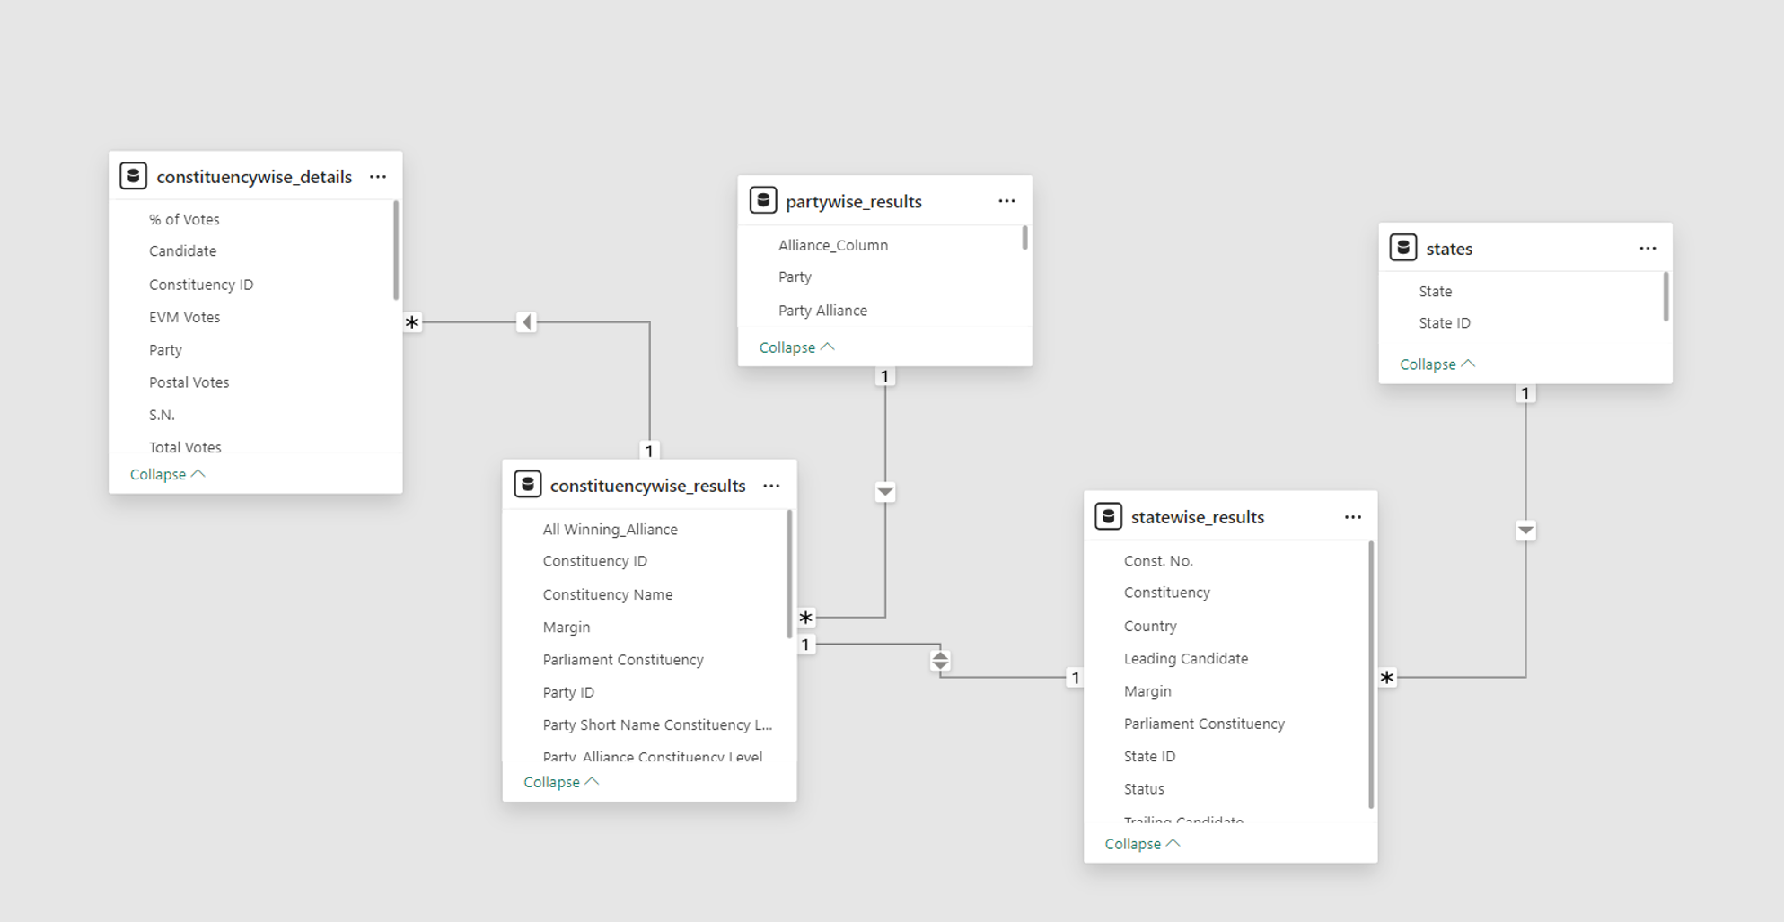
Advanced Data Modeling

